Slide 1



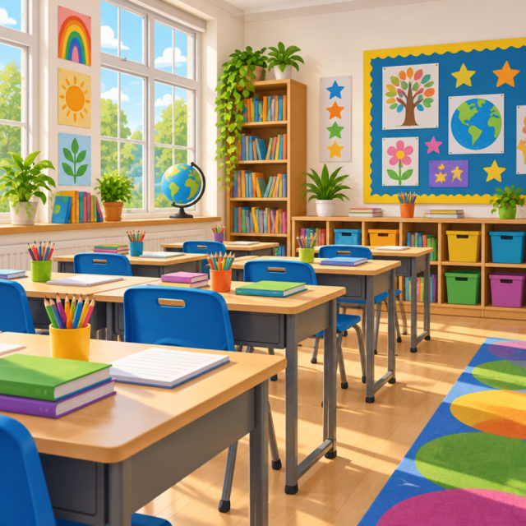
Welcome to Hobby Class
Year 5/6
Your guide to an exciting and successful year ahead.

Slide 2


The Year Ahead
We want every child to leave with three things:
Confidence — trying, explaining, asking questions and learning from mistakes.
Progress — knowing more, remembering more and becoming increasingly independent.
Readiness — the skills, habits and resilience needed for secondary school.

Slide 3

Our Golden Rules
At Westonzoyland, our classroom runs on kindness, teamwork, and mutual respect every day.
Respect everyone's right to learn
Care for our school environment
Move calmly, politely, and safely
🧠
Remember
Treat others exactly as you would like to be treated yourself.

Slide 4
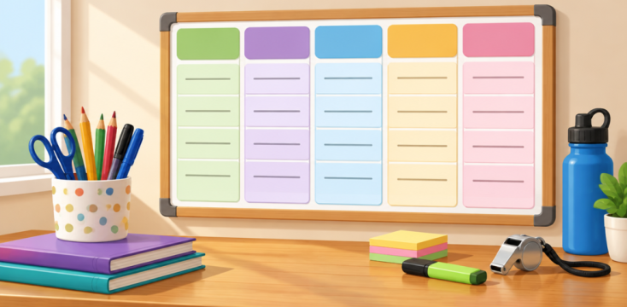
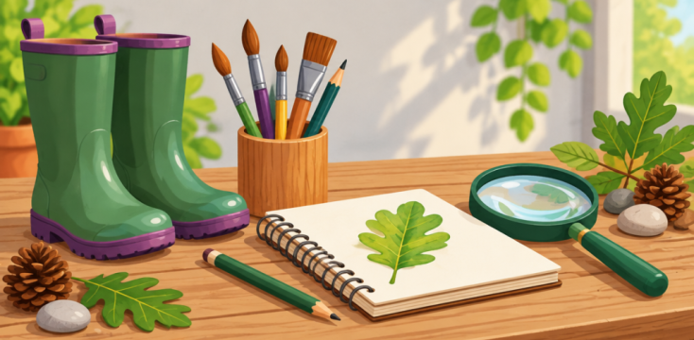
Our Weekly Routine
Wednesdays
Science with Mrs Hall.
PE with Mr Hudson
Friday afternoons
Opportunities for sports.
Golden time.
Outdoor learning.

Slide 5
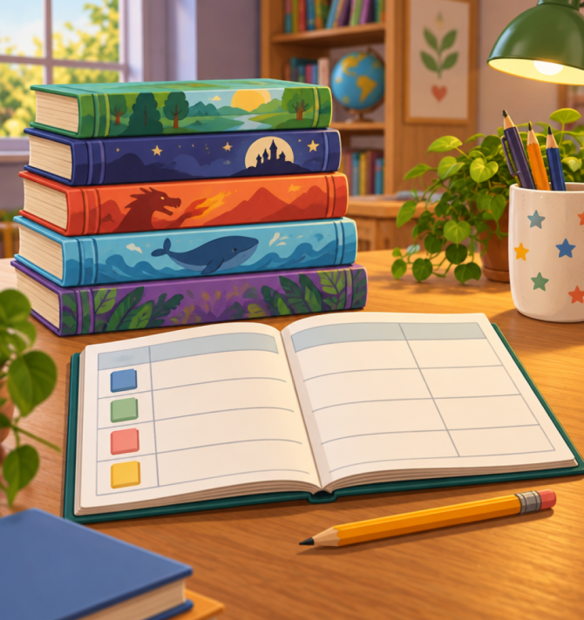
How We Help Every Child Progress
We are precise about what each child needs next.
Find the gap — use assessment, questioning, books and daily teaching to identify what is secure and what is not.
Teach the gap — revisit key knowledge, model carefully and provide small-group support or extra practice.
Check the impact — look for improved understanding, better work and growing independence.
🔑
Key point
The aim is not to make every child do the same thing. It is to help every child move forward.

Slide 6
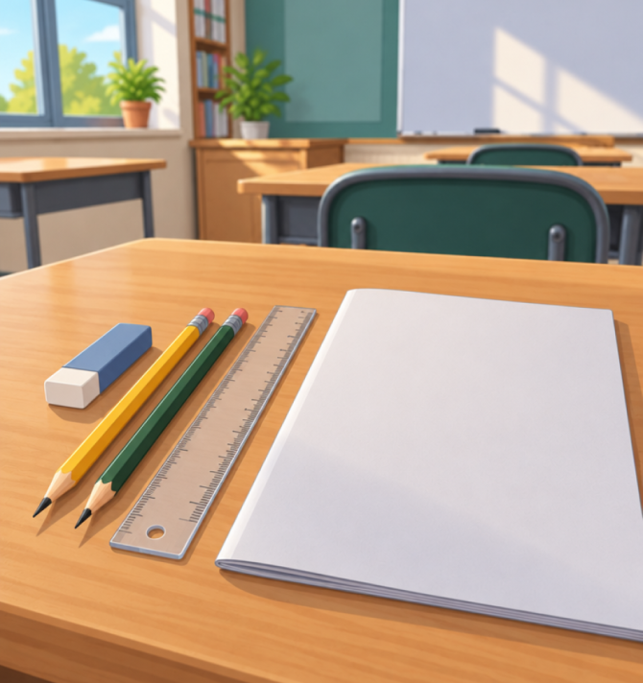
Year 6 Preparation: SATs and Beyond
SATs matter, but they are one part of a much bigger picture.
Quality-first teaching every day
Regular assessment and practice
Targeted support where gaps remain
Building confidence with unfamiliar questions
🔑
Beyond the tests
We also build organisation, responsibility, independence, resilience and positive relationships for a smooth transition to secondary school.

Slide 7
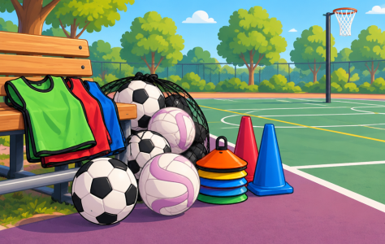
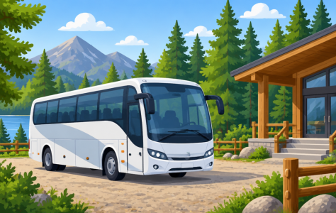

Trips, Clubs, and Celebrations
After-School Clubs - Opportunities to join sports teams, represent the school, and learn new skills.
Year 6 Milestones - End-of-year performances, leavers assemblies, shirt signings, and fundraising events.
Termly Class Trips - One class trip each term, plus a residential trip in June.

Slide 8
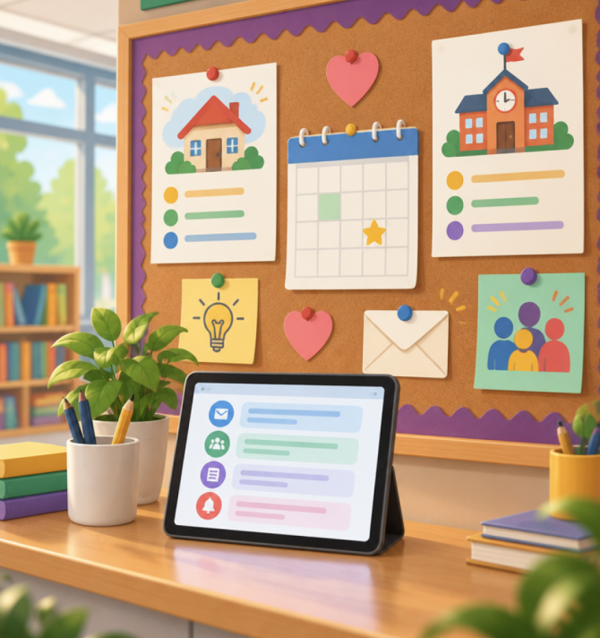
Working Together: Home, School and Routines
Small, consistent habits make a big difference.
At home: read regularly, talk about books, practise key facts and encourage children to explain their thinking.
At school: attend regularly, arrive ready to learn and take pride in effort, presentation and improvement.
Together: share concerns early, celebrate progress and treat mistakes as part of learning.
⚠️
Please remember
Reading at least five times each week, homework and spellings as shared, PE kit ready, and good attendance and punctuality.

Slide 9
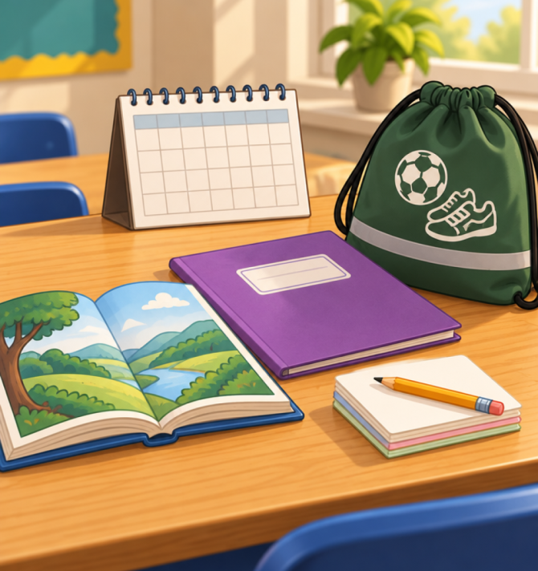
Contact
Please contact me if you have any questions of concerns.
Email:
My direct email address is the most convenient and quickest way to contact me (vicki.bell@wzps.co.uk).
Alternatively, please contact the school office (office@wzps.co.uk), catch me on the door, or arrange a meeting for after school/Wednesdays.
Communication between home and school is a priority. I will email you with any plans/changes to the timetable/specific events. If I forget anything, please give me a prompt and I’ll send out the information to everyone!

Slide 10
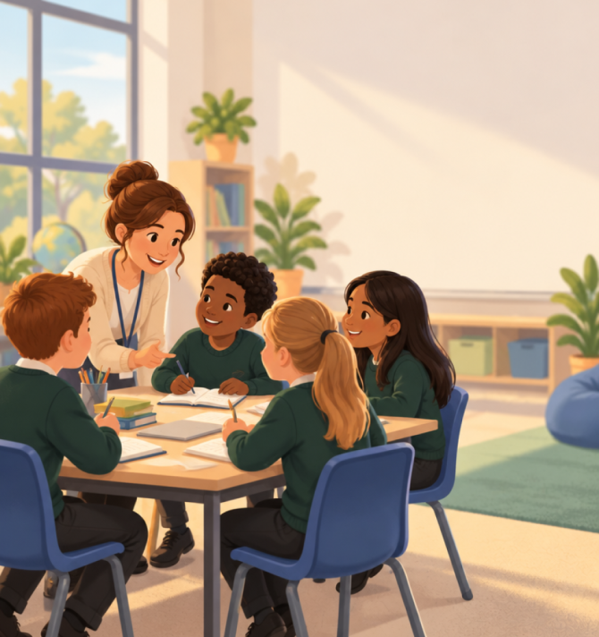
The Big Message
We know our children.
We know their next steps.
🔑
Key point
Our job is to teach precisely, support thoughtfully and make progress visible. Thank you for working with us.

