Slide 1
Year 3/4
Eagle and Osprey Class

Slide 2
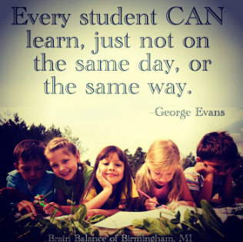

Slide 3
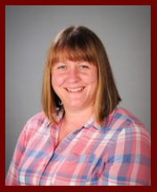
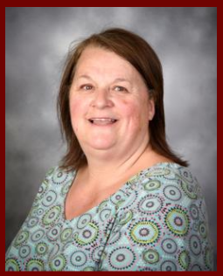
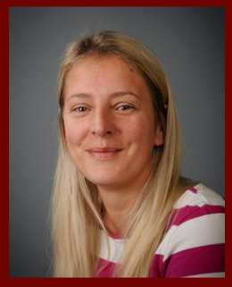
Teaching team - Eagle
Miss Victoria Evans
Class Teacher
Mrs Theresa Deabill
Class LSA
(Monday - Wednesday)
Mrs Kim Dunn
Class LSA - PM
(Wednesday - Friday)

Slide 4
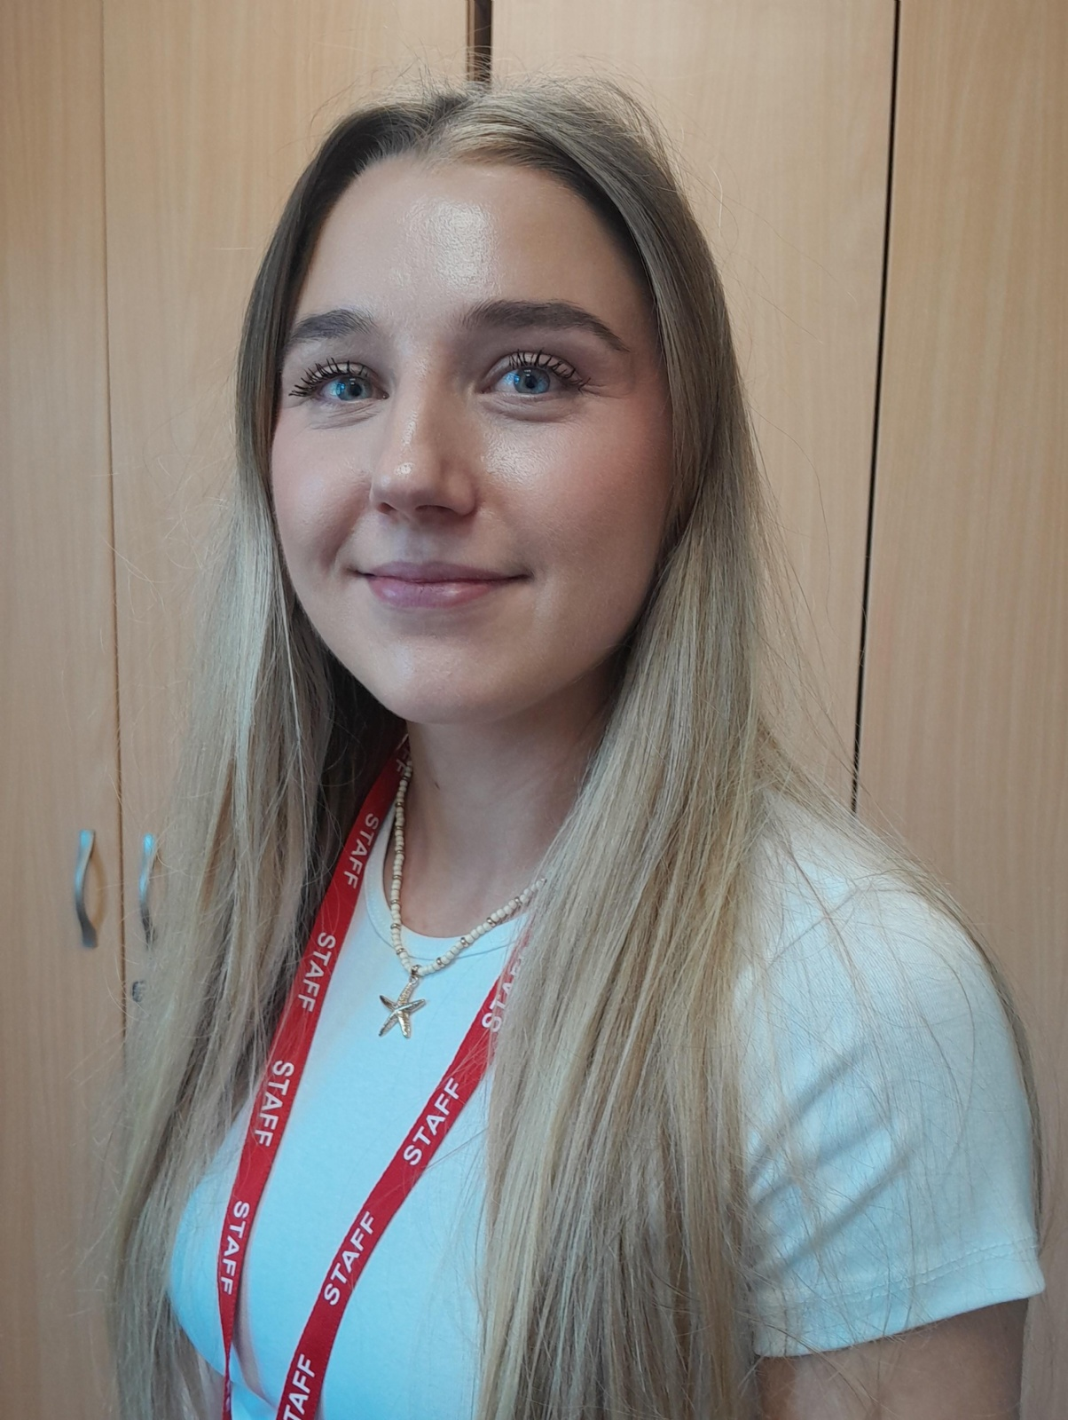
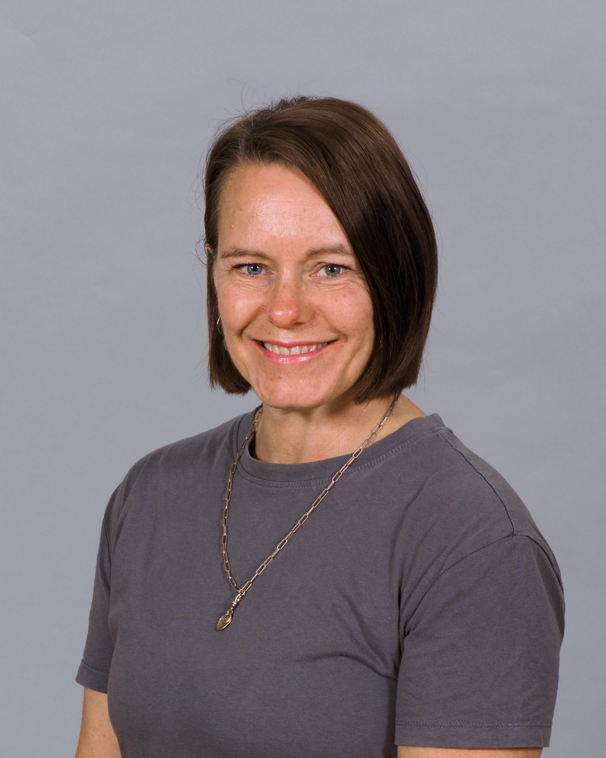
Teaching team - Osprey
Miss Chloe McCubbin
Class Teacher
Miss Kerry Williams
Class LSA

Slide 5
Class Routines
8.40 - 9.00 Children arrive/settling activities (Interventions/reading may be carried out during this time)
9.00-10:30 English
10.30-10.50 Playtime & Snack
10.50-12:15 Maths
12:15-1:15 Lunch & Playtime
1.15-3:00 Foundation Subjects (History, Geography, Science, ICT)/PE
3.00-3.15 Story

Slide 6



Behaviour for Learning
Positive Behaviour Policy:
Our Golden Rules
Rewarding the expected and exceptional learning behaviours:
Being ready to learn
Learning independently
Helping others to learn
Leading learning
Class Dojo
Reading rewards
Pen licences
Clear a concise behaviour management
Parental involvement

Slide 7

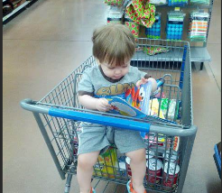
Reading
Reading is for pleasure it is not a chore.
Read 5 times a week.
Reading opportunities will be made available at breaktime for those that cannot find time to read at home.
Reading is an adventure and should be fun.

Slide 8
Spellings and Homework
Children are expected to read AT LEAST 5 times per week. Reading record books will be checked every morning and those who have not read will spend their playtime reading with an adult in school. The children will get lots of further opportunities to read in school.
Homework is Spelling Shed each week starting and ending on a Sunday. They need to practise their assigned spellings. Any extra time on 'Mastery zone' at home would benefit them greatly.
They also need to practise times tables on times tables.co.uk in preparation for the Year 4 Multiplication check.
Additional home learning and extension activities are available to the children but are non-compulsory.

Slide 9
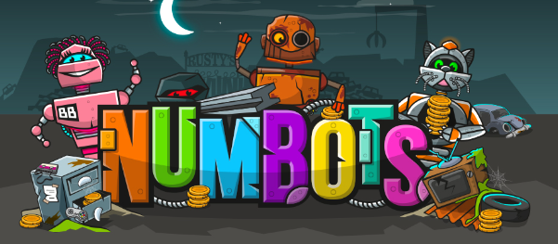
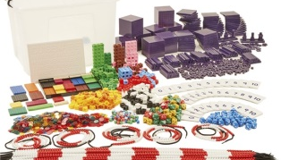
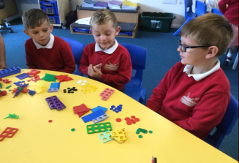
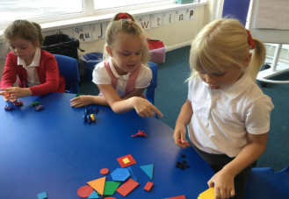
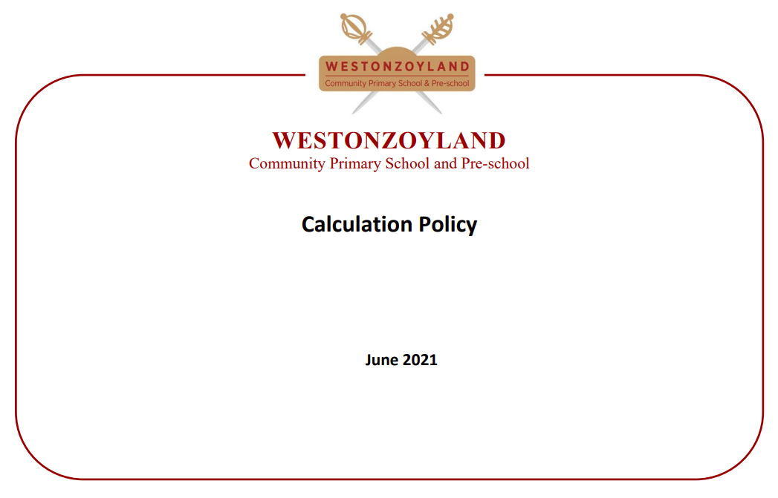
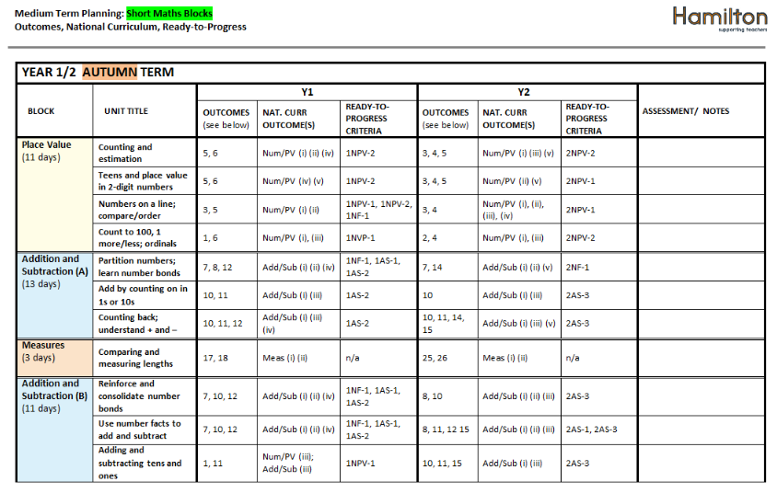

Maths

Slide 10
Year 4 Multiplication Tables Check
What is the MTC?
The Multiplication Times Tables Check is an online test where the pupils are asked 25 questions on times tables 2 to 12. For every question, you have 6 seconds to answer, and in between the questions, there is a 3-second rest. Questions about the 6, 7, 8, 9, and 12 times table come up more often. The questions are generated randomly based on the rules of the MTC.
Preperation
The Multiplication Times Tables Check is an online test where the pupils are asked 25 questions on times tables 2 to 12. For every question, you have 6 seconds to answer, and in between the questions, there is a 3-second rest. Questions about the 6, 7, 8, 9, and 12 times table come up more often. The questions are generated randomly based on the rules of the MTC.
MTC will be administered in June
Daily times table tests
Hit the button
Times tables.co.uk for MTC practise
To pass, you need to get 25/25

Slide 11
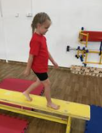
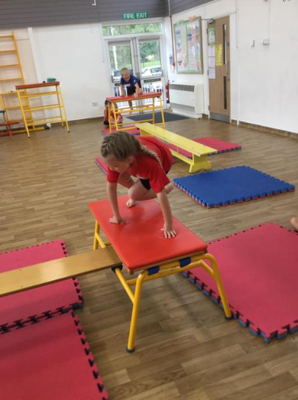
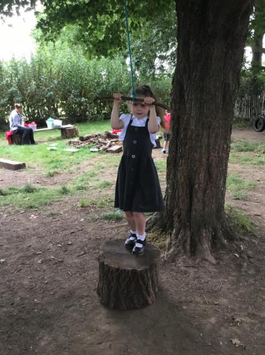
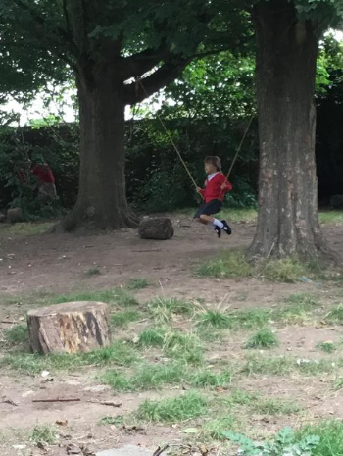
PE/Outdoor learning

Slide 12
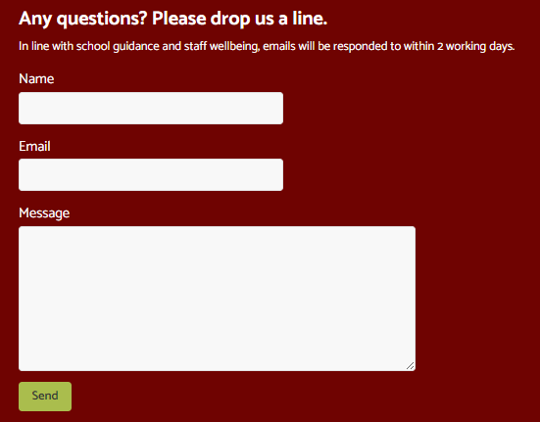
Keeping you informed
School website updated regularly with pictures and information
Work/notices on classroom window
Emails that are checked regularly and responded to promptly
Parents evenings
Workshops (Reading/Phonics planned for this term)
Book Shares/Art galleries/reading time

Slide 13
Attendance
Regular school attendance is essential for your child's success. Being in school every day helps children build strong learning habits, develop friendships, and stay up to date with their lessons. Missing school can make it difficult to keep up with learning and may affect confidence and achievement. By ensuring your child attends school regularly and arrives on time, you are giving them the best opportunity to reach their full potential.
Regular school attendance is essential for your child's success. Being in school every day helps children build strong learning habits, develop friendships, and stay up to date with their lessons. Missing school can make it difficult to keep up with learning and may affect confidence and achievement. By ensuring your child attends school regularly and arrives on time, you are giving them the best opportunity to reach their full potential.

Slide 14
Social Media
Monitoring your child's social media use is an important part of keeping them safe online. Regularly checking the apps they use, the content they view, and who they communicate with can help protect them from online risks such as cyberbullying, inappropriate content, and contact from strangers. Open conversations about responsible online behaviour can also help children make safe and positive choices.

Slide 15
Reminders
Please name all items of clothing and equipment
Water bottles for use in the classroom
Reading record books checked daily
Books will be changed as required, but at least weekly
Email in any pictures/news to share in class
Please ensure contact details stay up to date
Please update photo consent for you child – I have a lot of photos already waiting to go on the website ☺

Slide 16
Concerns
We aim to resolve any concerns by working in partnership with you.
In the first instance, please chat to Mrs Hall or Miss McCubbin at the start or end of the day or drop us an email. For a longer meeting, we will book you an appointment
If you are unhappy with the response, please ensure that your concerns are put in writing and emailed via the contact us page at the bottom of the class webpage.
If your concern is not resolved, please contact a member of our Senior Leadership Team:
SENDcO: Mrs Bridgeman
Deputy Headteacher: Mrs Bell
Headteacher & safeguarding lead: Mr Clark
If you have an SEN concern, please email Mrs Bridgeman who will talk you through any next steps.

Slide 17
Any Questions?

