Slide 1

Kestrel Class
2026-27

Slide 2
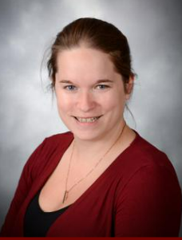
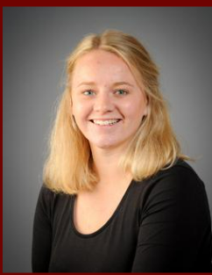
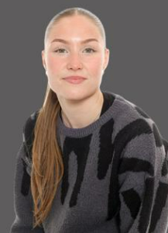
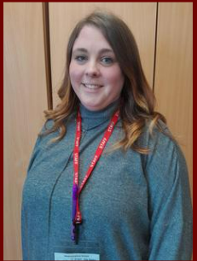
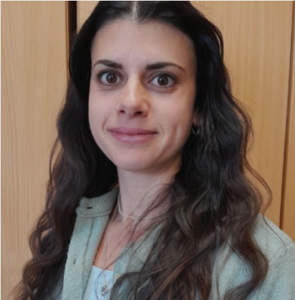
Teaching team
Mrs Meyers Mrs Bridgeman Miss Bell Miss Rich Miss Clark
Mon, Tues AM
Thurs Fri
Tues PM
Wed
Mornings
Mornings
Friday

Slide 3
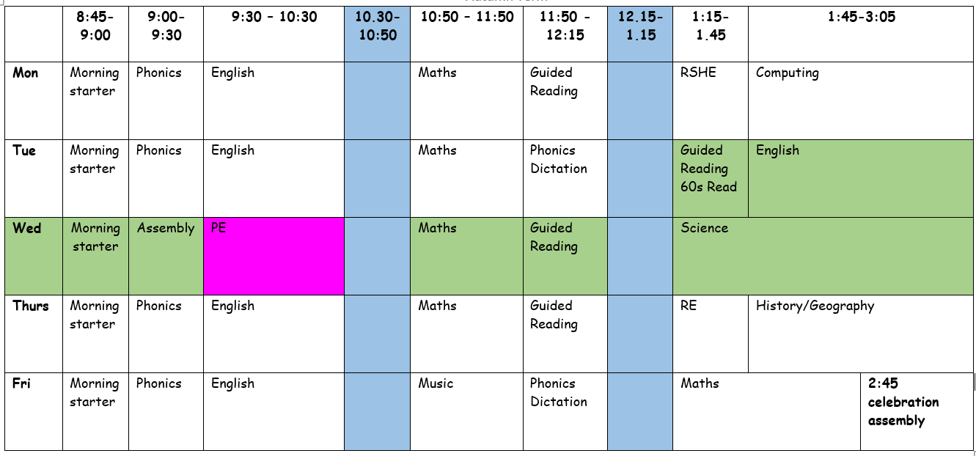
Class Routines

Slide 4
Reminders
Please name all items of clothing and equipment.
Any questions about school uniform please ask – this can also be found on the website.
Water bottles for use in the classroom. Children must only have water.
Fruit and vegetables at snack time – this is provided by the school.
Please ensure contact details stay up to date.
If your child has medication, please take this to Ms Touchin who will provide you with the required forms so we can administer this in school.

Slide 5

Writing
Daily phonics
Phonics revision and interventions
Common exception words
Handwriting practise daily
Guided reading sessions taught

Slide 6
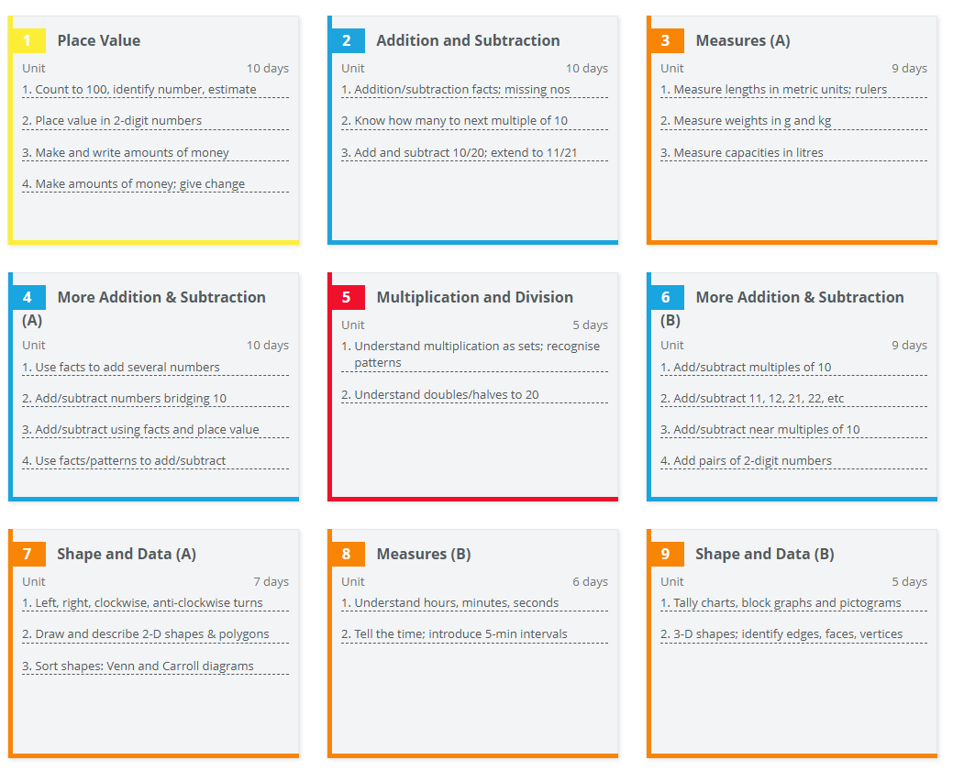
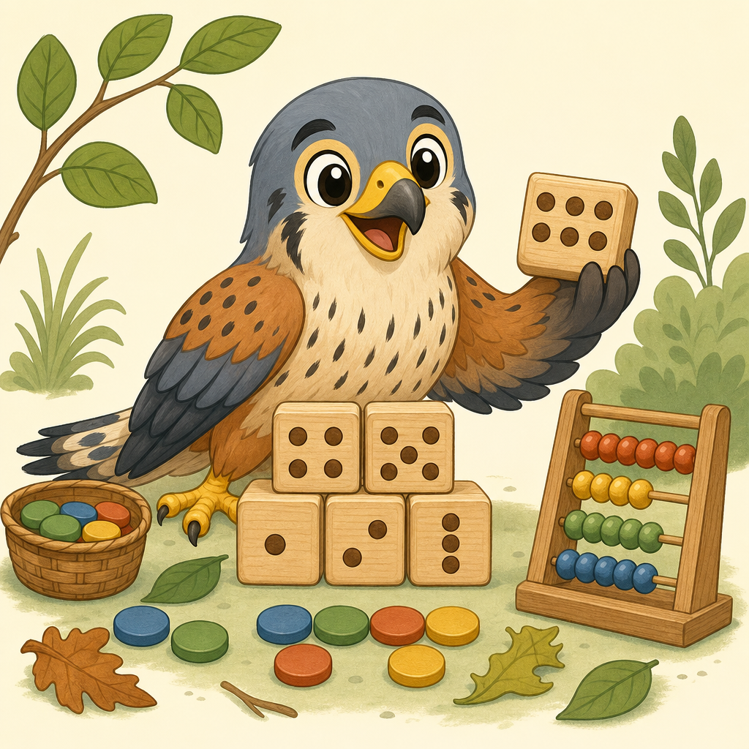
Maths

Slide 7
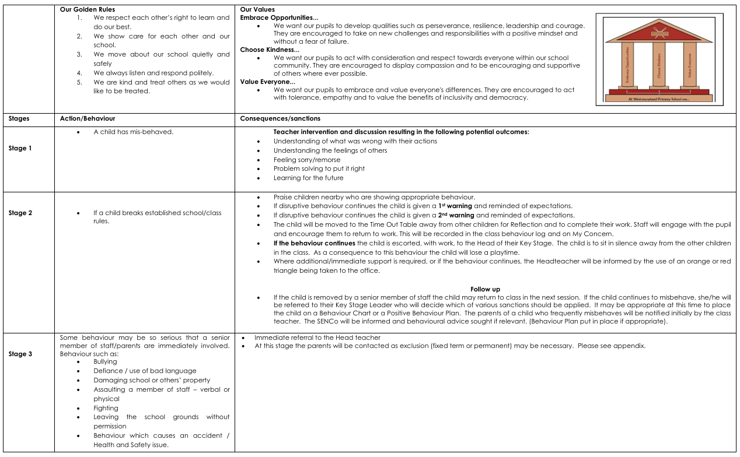
Behaviour for Learning

Slide 8
Helping at Home
Reading 5 times a week – records will be checked daily
Common Exception Word practise
Handwriting and weekly phonics words are available
PE kits to be worn on Wednesdays
Outdoor learning will start after the October half term- we will be in touch about when
Show and Tell Fridays – please keep an eye out for your child’s date each term.

Slide 9
Keeping you informed
School website updated regularly with pictures and information as well as social media pages
Weekly newsletter from Mr Clark
We will send any reminders via email
‘Contact me’ page on the class website
Any emails to the school office will be forwarded on
We will be on the door every morning and at the end of the day
Parents’ evenings and written reports

Slide 10
Questions

